Slide 1
Structural Health Monitoring System
-Kenneth Pereira
NU ID: 001686410

Slide 2
Problem Statement
Many historical buildings and bridges today require maintenance and continuous monitoring of the actual condition of the buildings and the external agents which worsen the conditions of the building.
All governmental and private organizations want to detect damage in their infrastructure at the earliest time.
The periodic structural testing by human operators are expensive and time-based i.e. they are not proactive so this makes it difficult to detect any kind of damages or analyze the situation of the infrastructure during natural calamities.
Identification of such kind of damage has life-safety kind of implications. There is a need to identify and locate the damage, understand the severity and forecasts the effect of the damage on the long term health of the infrastructure.

Slide 3
Proposed Solutions
Using the principles of Internet of things we can use sensors to detect damages in the structures of a building / bridges.
The sensor data will point out the location of the damage (cracks, strength) in the architecture.
The data can be collected in a near real-time frame so the architectures can be monitored proactively.
The data can be stored on a cloud where Business Intelligence Analytics can be performed to determine the longevity of the architecture.

Slide 4
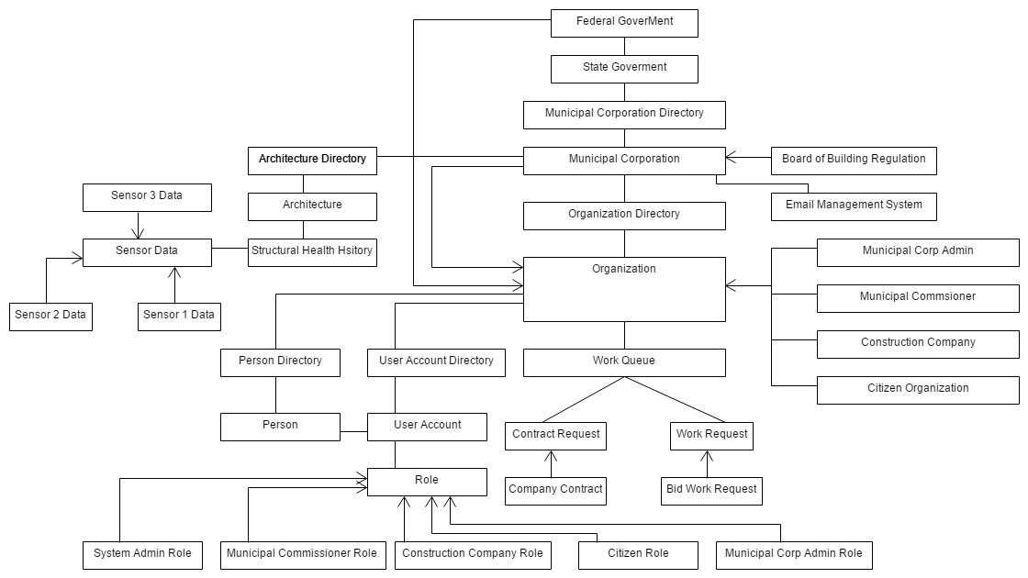
Object Model Diagram

Slide 5
Key Roles
Municipal Corp Admin
Creation of organizations in the system.
Creation of Entities for respective organizations.
Creation of credentials for individual entity.
Municipal Commissioner
Welcoming open bids for maintenance contract of architectures in the city.
Allocation of contracts to the construction company.
Maintaining Reports and Audit for all the contracts in the system.

Slide 6
Construction Company
Placing Bids for the projects offered by the Municipal Commissioner.
On getting awarded with a contract the company will place sensors (piezoelectric sensors) on the architecture.
Collect Sensor data.
Use Predictive analyzer to detect the current location of the damage in the architecture and decide the longevity of the architecture.
Generate reports based on the sensor data.
Alert citizen immediately if the architecture is unstable.
Citizen
Under RTI the citizen can log in to check the ongoing projects conducted by the Municipal Corporation.
Look out for the unsafe building in the city.
Check structural health ranking of various buildings

Slide 7
Key Features
Structured Queues for conducting open bids and allocation of contracts. This helps in bringing transparency to the process.
Near simulation of piezoelectric sensor for monitoring the health of the structure.
Collection of sensor data for generating business intelligence reports.
Predictive Analysis on the longevity and health of the structure.
Generation of Structural Health rank for the architectures.

Slide 8
Key Features
Credentials for citizens to verify the progress made by the construction companies.
Citizens have access to the reports of the contracts awarded by the municipal corporation.

Slide 9
Extra Features
Alert Management system which notifies citizens via email if the structures are critical.
Sending companies notifications about the projects available to bid.
Sending Municipal Commissioner status of the on going project.

Slide 10
References
An introduction to structural health monitoring - BY CHARLES R. FARRAR1 AND KEITH WORDEN2
Internet of Things for Smart Cities - By Andrea Zanella (Senior Member, IEEE), Nicola Bui, Angelo Castellani, Lorenzo Vangelista (Senior Member, IEEE), and Michele Zorzi, (Fellow, IEEE)

Slide 11
THANK YOU.

